Slide 1
The Problem
Notes:
CLICE 1 <In this video, we'll discuss data analysis and the scenario in which we'll play the data analyst or data scientist. This course will take you from the basics of data analysis in Healthcare with Python to building and evaluating data models. We'll use Jupyter notebooks and several Python tools and libraries to clean the data set, apply statistical techniques to test several hypotheses about the data, and visualise the data to determine the relationships between variables.>

Slide 2
Why Data Analysis?
Data is everywhere, especially in healthcare.
Data analysis/data science helps us answer questions from data in the healthcare.
Data analysis plays an important role in healthcare:
Discovery of useful information
Answering questions
Prediction of the future or the unknown in healthcare
Notes:
<But before we begin talking about the problem in Healthcare, we should first understand the importance of data analysis.>
CLICE 1 <As you know, data is collected everywhere around us.
Whether it's collected manually by scientists or digitally, every time you click on a website or your mobile device.
But data does not mean information.
CLICE 2 <Data analysis and data science help us unlock the information and insights from raw data to answer our questions.
So data analysis plays a vital role by allowing us to discover helpful information from the data, answer questions and even predict the future or the unknown.
So let's begin with our scenario.>

Slide 3
The doctor analyses the data about the patient
What variables affect the patient's health?
The doctor's task is to predict heart disease based on the selected signs
Notes:
CLICE 1 <For example, consider a situation when, based on the patient's laboratory and biological data, it is possible to determine the risks of heart disease using machine learning methods. >
CLICE 2 < For an accurate prognosis, the doctor must have enough data about the patient's condition in the database.>
cLICE 3 <After all, heart disease is a severe problem caused by many problems and many factors, such as cholesterol, blood sugar, etc., that affect the patient's health. Therefore, the doctor's task is to predict heart disease based on the selected signs.>

Slide 4
Assessment of the patient's health
How can we help the doctor to determine the patient's health condition?
Some factors affect the patient's health:
such as cholesterol, blood sugar, etc.? Something more?
Ask the patient the right questions about the data
Notes:
CLICE 1 <Assessment of the patient's health>
CLICE 2 <How can we help the doctor to determine the patient's health condition?
CLICE 3 <Some factors affect the patient's health:>
<• such as cholesterol, blood sugar, etc.? Something more?>
<• Ask the patient the right questions about the data>

Slide 5
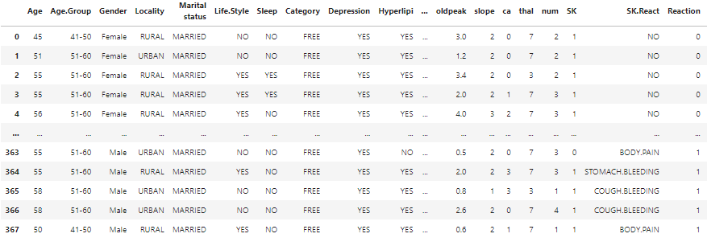
Patient history medical data set
Data source: https://www.kaggle.com/datasets/asgharalikhan/mortality-rate-heart-patient-pakistan-hospital
Notes:
CLICE 1 <As a data analyst or data scientist, these are some questions we can begin to consider. To answer these questions, we need some data.>
CLICE 2 <In our case, the Heart Failure Dataset is an online source, and it is in a CSV (comma separated value) format. Let's use this dataset as an example to practice data reading.>

Slide 6

IBM Developer
Notes:
CLICE 1 <In the following videos, we will tell you how to understand the data, import it in Python, and start learning some basic ideas from data.>

